Slide 1


Travis Thomas
June 22, 2023

Slide 2

Outline
Executive Summary
Introduction
Methodology
Results
Conclusion
Appendix

Slide 3
Executive Summary
Summary of methodologies
Data Collection using SpaceX API
Data Collection using Web Scraping
Data Wrangling
Exploratory Data Analysis using SQL
Exploratory Data Analysis with Data Visualization
Interactive Visualization with Folium and Plotly Dash
Predictive Analysis using Machine Learning
Summary of all results
Exploratory Data Analysis Results
Screenshots of Interactive Analysis
Results of Predictive Analysis

Slide 4
Introduction
Project Background and Context
SpaceX advertises Falcon 9 rocket launches on its website at a cost of $62 million while other providers launches cost upwards of $165 million each. Much of SpaceX lower cost is due to the reusable nature of its rocket’s first stage.
If we can determine whether a first stage will land, we may be able to determine the cost of a launch.
This information could be used to support competitive bids for launches against SpaceX.
We will create a machine learning pipeline to attempt to predict whether the first stage of a SpaceX Falcon 9 rocket will land successfully.
Problems you want to find answers
What factors determine whether a rocket will land successfully?
How do the various determining factors interact between successful and unsuccessful launches?
What operating conditions need to exist to maximize the probability of a successful landing?

Slide 5

Section 1

Slide 6
Methodology
Executive Summary
Data collection methodology:
Data for analysis was collected using the SpaceX API and Wikipedia.
Perform data wrangling
Categorical features were encoded using “One-Hot” encoding.
Perform exploratory data analysis (EDA) using visualization and SQL
Perform interactive visual analytics using Folium and Plotly Dash
Perform predictive analysis using classification models
Construct, train, and evaluate various classification models to determine the optimal predictive model.

Slide 7
Data Collection
Data was collected using a Get request to the SpaceX API.
Next, the response content was decoded as a Json object using the .json() method, which was then converted into a Pandas dataframe using the .json_normalize() method.
Data was then checked for missing values and missing values were replaced with the mean of the column, when necessary.
Additional data was scraped from the Wikipedia page of Falcon 9 launches using a BeautifulSoup object.
Data was then converted to a Pandas dataframe by parsing the HTML page for tabular data.

Slide 8
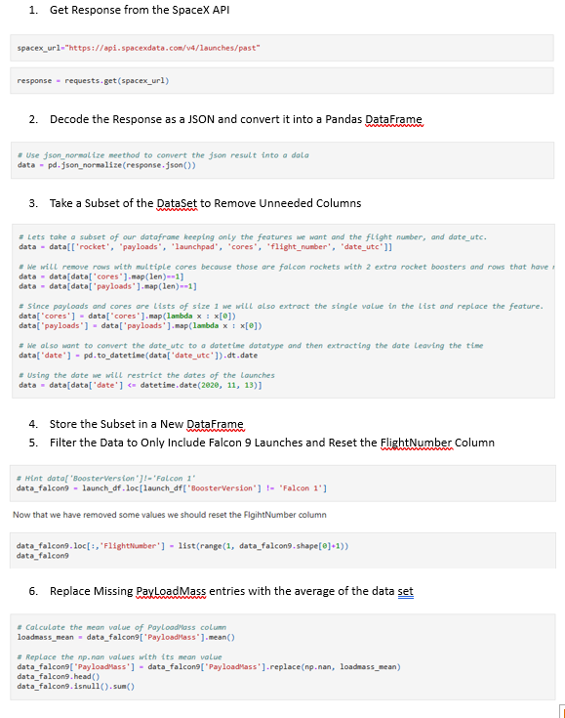
Data Collection – SpaceX API
Data was collected using SpaceX’s REST API.
IBM-Data-Science-Capstone/Lab 1.ipynb at main · travt2000/IBM-Data-Science-Capstone (github.com)

Slide 9
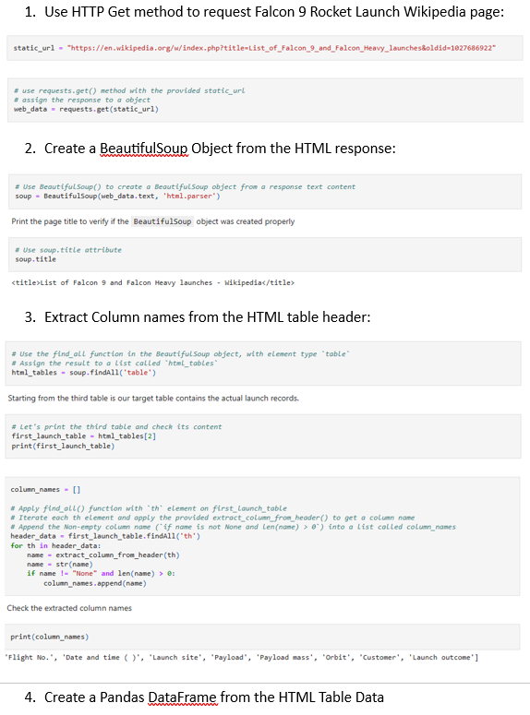
Data Collection - Scraping
Web scraping was used to collect Falcon 9 launch records with BeautifulSoup and then converted to a Pandas Dataframe.
IBM-Data-Science-Capstone/Data Science Captsone - Web Scraping.ipynb at main · travt2000/IBM-Data-Science-Capstone · GitHub

Slide 10
Data Wrangling
Data wrangling was performed to determine training labels and perform initial exploratory data analysis.
The percentage of missing values was determined for each attribute.
The number of launches per launch site, the number of launches by orbital type, and the number of mission outcomes by orbital type were calculated.
Launch outcomes were analyzed and a binary landing Class column was created.
IBM-Data-Science-Capstone/IBM-DS0321EN-SkillsNetwork_labs_module_1_L3_labs-jupyter-spacex-data_wrangling_jupyterlite.jupyterlite.ipynb at main · travt2000/IBM-Data-Science-Capstone · GitHub

Slide 11
EDA with Data Visualization
Scatter plot of Flight Number vs Launch Site. Used to identify any trend in the usage of launch sites and the successes of launches over time.
Scatter plot of Payload vs Launch Site. Used to analyze payload sizes launched at different launch sites.
Bar Chart of Success Rate by Orbit Type. Used to analyze which orbits result in the most successful launches.
Scatter plot of Flight Number vs Orbit Type. Used to changes in orbit type over time.
Scatter plot of Payload and Orbit Type. Used to analyze the size of payloads used in different orbital missions.
Line chart of Launch Success Rate vs Year. Used to see changes in mission success over time.
IBM-Data-Science-Capstone/IBM-DS0321EN-SkillsNetwork_labs_module_2_jupyter-labs-eda-dataviz.ipynb.jupyterlite.ipynb at main · travt2000/IBM-Data-Science-Capstone · GitHub

Slide 12
EDA with SQL
The SpaceX data set was loaded into an SQLLite database within the Jupyter notebook.
Various SQL queries were used to gain insight into the data. Queries were performed for the following questions:
The names of unique launch sites
The total payload mass carried by rockets launched for NASA (CRS)
The average payload mass by rocket booster version F9 v1.1
The total number of successful and failure mission outcomes
The failed landing missions in drone ship including their booster version and launch site names.
For detailed results, please see the included notebook:
IBM-Data-Science-Capstone/jupyter-labs-eda-sql-coursera_sqllite.ipynb at main · travt2000/IBM-Data-Science-Capstone · GitHub

Slide 13
Build an Interactive Map with Folium
Individual launch sites were marked and labelled and clusters of icons were added to note the number of successful and failed missions. In addition, locations such as coastlines and nearby cities were marked along with lines showing the distance from the launch site.
Color coded clusters were used to note the number of launches at each site and the number of successful and failed missions.
Nearby coastlines and cities were marked and labelled along with lines to denote the distance to the launch site.
It was found that all launch sites are near coastlines.
Launch sites are located well away from nearby cities.
IBM-Data-Science-Capstone/Folium Captsone Project.ipynb at main · travt2000/IBM-Data-Science-Capstone · GitHub

Slide 14
Build a Dashboard with Plotly Dash
Plotly Dash was used to create an interactive dashboard to analyze launch sites and the relationship between successful/failed missions and payload mass by booster version.
Pie charts were used to show total launches by site and successful and failed missions at each site.
Scatter plots were used to show the relationship between mission outcome and payload mass for each booster version.
Source code for the Plotly Dash dashboard can be found at: IBM-Data-Science-Capstone/main.py at main · travt2000/IBM-Data-Science-Capstone · GitHub

Slide 15
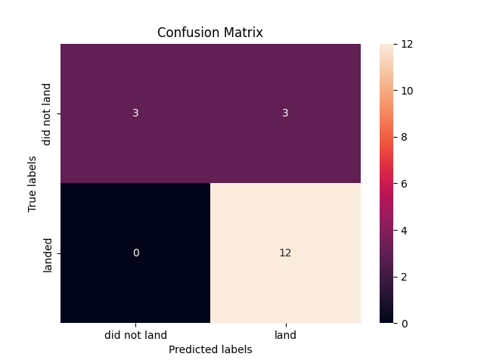
Predictive Analysis (Classification)
Logistic Regression, Support Vector Machines, Decision Trees, and K-Nearest Neighbors Algorithms were used for predictive analysis using the Falcon 9 launch data set.
The data set was broken into a Training and Test set sets with the Test set including 20% of the total data set.
All 4 models produced an F1 score of approximately 0.83333.
Each model correctly predicted all successful landings but correctly predicted only 50% of failed landings.
IBM-Data-Science-Capstone/IBM-DS0321EN-SkillsNetwork_labs_module_4_SpaceX_Machine_Learning_Prediction_Part_5.jupyterlite (1).ipynb at main · travt2000/IBM-Data-Science-Capstone (github.com)

Slide 16
Results
A Decision Tree model produced the best overall accuracy, but all 4 models used produced similar results in terms of accuracy and precision.
The success rate for SpaceX launches is directly proportional to the date of the launch, indicating improving performance as the launch process and technology continues to be refined.

Slide 17

Section 2

Slide 18
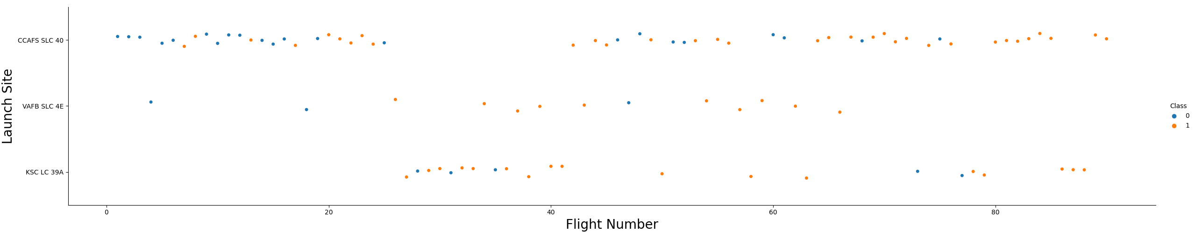
Flight Number vs. Launch Site
There have been significantly more launches from site CCAFS SLC 40 than any other launch site.

Slide 19
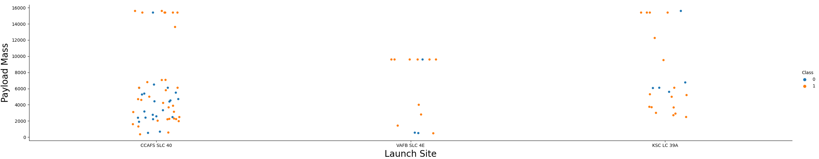
Payload vs. Launch Site
Launch site VAFB SLC 4E has had no launches with payloads of 10,000kg.
Launch site CCAFS SLC-40 has had a higher volume of launches with most launches being of lower payload mass.

Slide 20
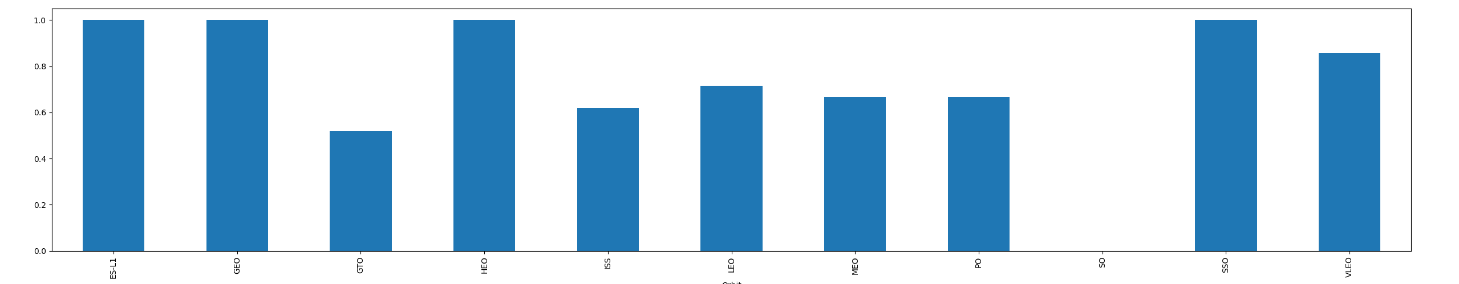
Success Rate vs. Orbit Type
Orbit types ES-L1, GEO, HEO, and SSO have high success rates at or near 100%
Orbit type SO has had no successful missions
Other orbit types have had varying success rates.

Slide 21
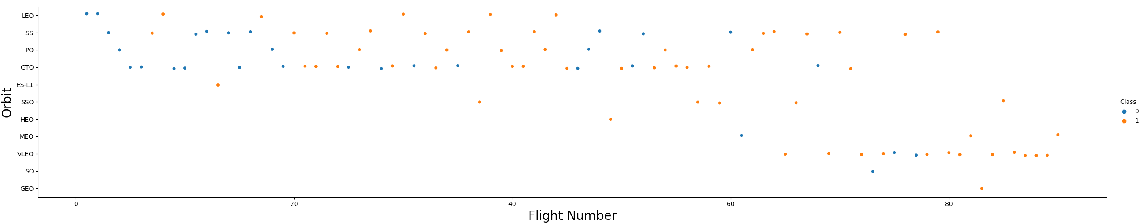
Flight Number vs. Orbit Type
Later launches have been primarily VLEO launches.

Slide 22
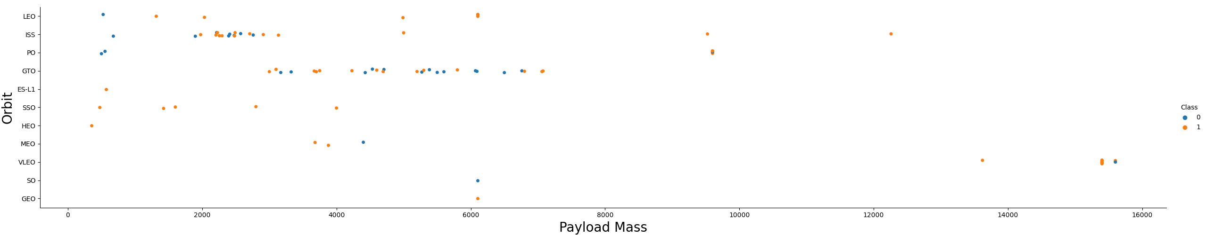
Payload vs. Orbit Type
There is a relationship between orbit classes and payload masses.
Higher orbits typically have larger payload masses.
Lower orbits typically have lower total payload masses.

Slide 23
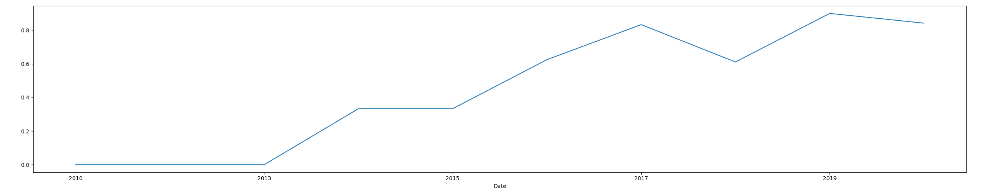
Launch Success Yearly Trend
Launch success rates have improved over time with a significant improvement after 2013.

Slide 24
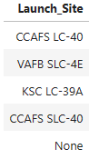
All Launch Site Names
The query selects distinct launch sites from the SpaceX table.

Slide 25
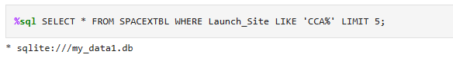
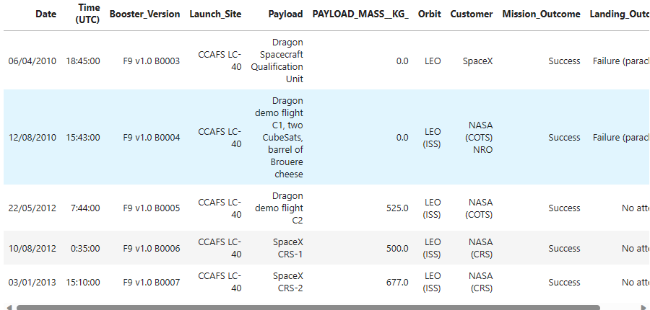
Launch Site Names Begin with 'CCA'
The query returns a total of 5 records where the launch site name begins with CCA.

Slide 26
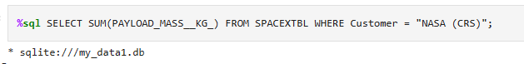
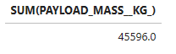
Total Payload Mass
The query returns the total (sum) mass of all launches by NASA.

Slide 27
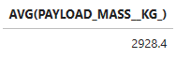
Average Payload Mass by F9 v1.1
The query returns the average payload mass carried by booster version F9 1.1.

Slide 28

First Successful Ground Landing Date
The query returns the earliest date of a successful ground pad launch.

Slide 29
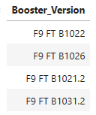
Successful Drone Ship Landing with Payload between 4000 and 6000
The query returns the list of boosters which have successfully landed on drone ship and had payload mass greater than 4000 but less than 6000

Slide 30
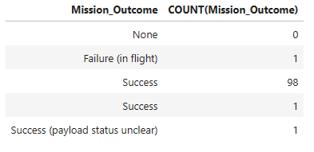
Total Number of Successful and Failure Mission Outcomes
The query returns the total number of successful and failed missions.

Slide 31
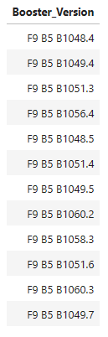
Boosters Carried Maximum Payload
The query returns the names of booster versions that have carried the maximum payload mass.

Slide 32
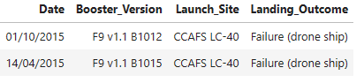
2015 Launch Records
The query returns a list of failed landings in drone ship along with their booster version and launch sites.

Slide 33
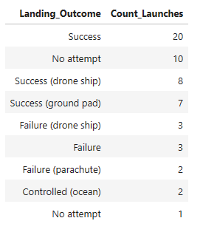
Rank Landing Outcomes Between 2010-06-04 and 2017-03-20
The query returns the count of landing outcomes from 2010-06-04 and 2017-03-20 ranked by outcome, in descending order.

Slide 34

Section 3

Slide 35

Falcon 9 Launch Sites
All Launch Sites are Located in Coastal Areas, Away from Large Cities

Slide 36
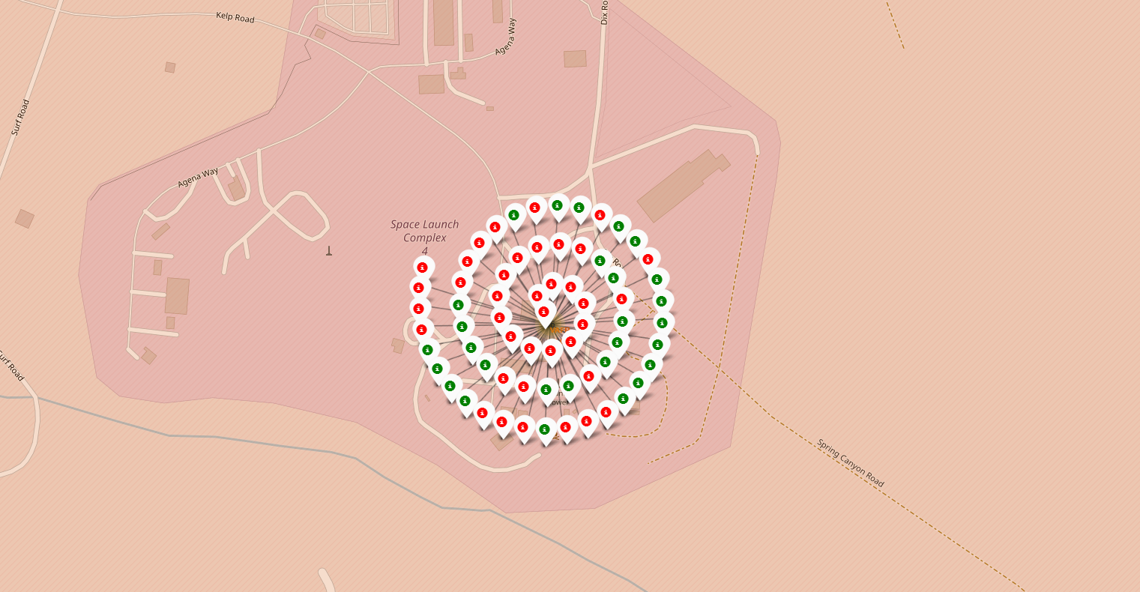
Successful and Failed Launches Plot
Launch site VAFB SLC-4E had 66 launches. Successful launches are labeled in green and failed launches are labeled in red.

Slide 37
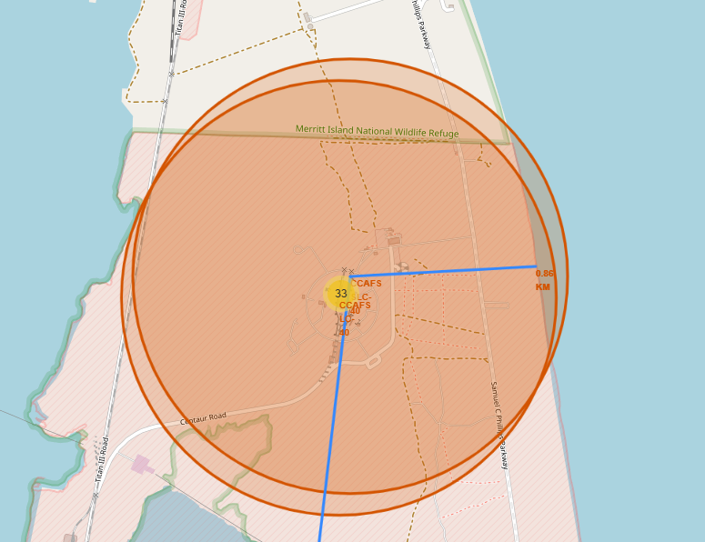
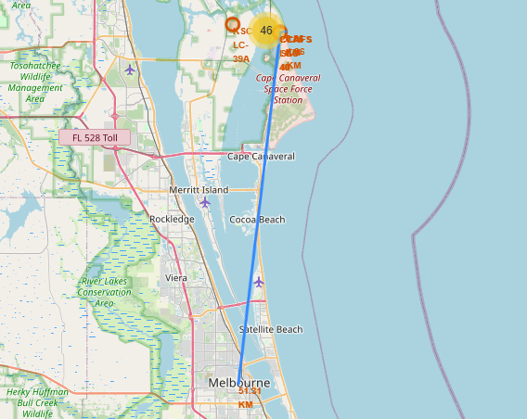
Launch Site Geographic Features
Launch Site CCAFS is located 0.86km from the coast
Launch site CCAFS is located 51.21km from Melbourne, FL.

Slide 38

Section 4

Slide 39
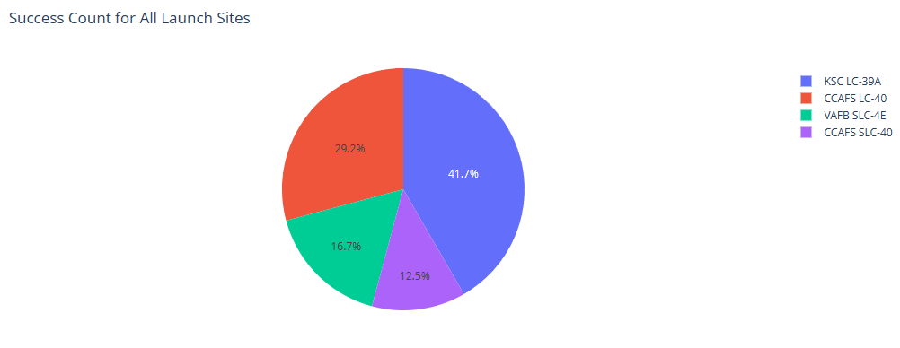
Total Successful Missions by Launch Site
Site KSC LC-39A the most successful launches among the launch sites.

Slide 40
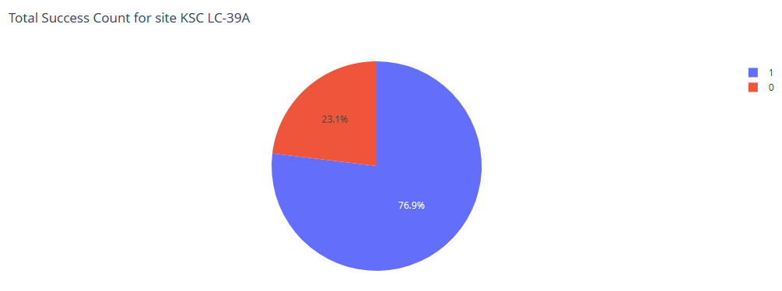
Success Rate by Site – KSC LC-39A
76.9% of site KSC LC-39A’s launches have been successful.

Slide 41
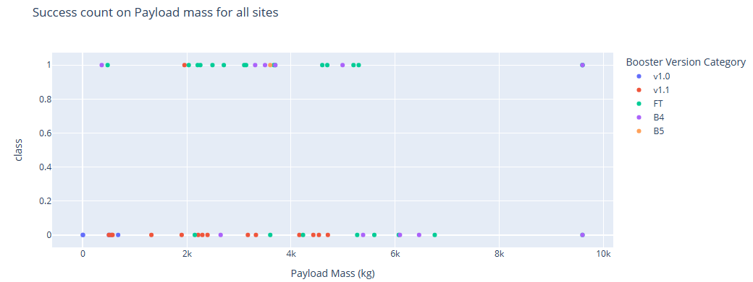
Success Rate by Payload Mass for All Sites
Across booster versions, the success rate is higher with lower payload masses.

Slide 42
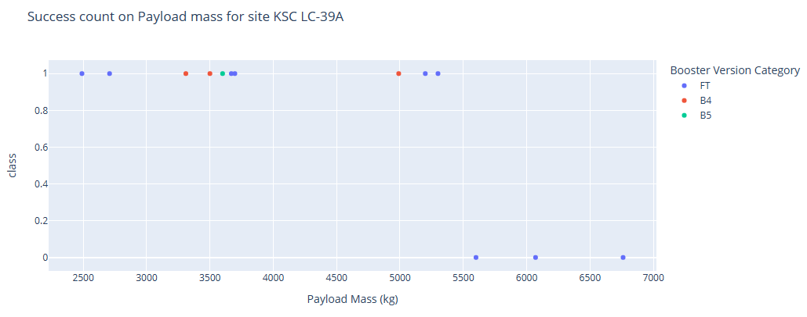
Success Rate by Payload Mass – Site KSC LC-39A
Site KSC LC-39A launches are typically of a lower total payload mass. This correlates to the site’s high success rate.

Slide 43

Section 5

Slide 44
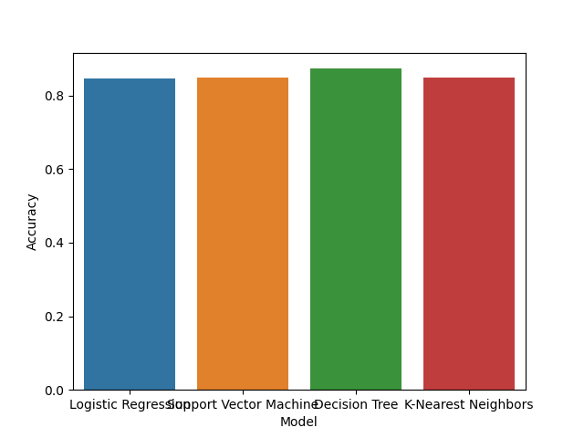
Classification Accuracy
The Decision Tree showed the highest model accuracy.

Slide 45
Confusion Matrix
The Decision Tree accurately predicted all successful launches.
The Decision Tree correctly predicted 50% of unsuccessful launches.
The best_score_ method showed that the Decision Tree was slightly more accurate than the other models used.

Slide 46
Conclusions
The Decision Tree delivered the highest numerical accuracy.
The Confusion Matrixes showed that all 4 models accurately predicted all successful launches and correctly predicted 50% of failed launches.
F1 scores for all models (score() method) was 0.833333. This indicates that all 4 models had the same level of accuracy and precision.

Slide 47


